Slide 1
Density Based Clustering
By
Dr. S PADMANABHAN

Slide 2
Density Based Clustering
DBSCAN (Density-Based Spatial Clustering of Applications with Noise) is mostly used density-based clustering algorithm
This technique can form clusters of non-linear shapes
It considers a cluster as a continuous region of high density
Regions of low density are identified as noise/ outliers

Slide 3
Parameters in DBSCAN
There are two parameters in the DBSCAN algorithm:
epsilon (ε) and
the minimum number of samples (min_samples or minPts)
epsilon (ε) is the radius of the neighbourhood for a data point
Minimum number of samples is the lower bound for the count of data points in the neighbourhood of a core point

Slide 4
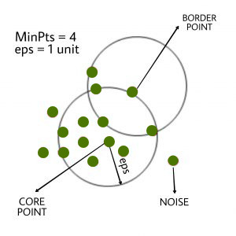
DBSCAN
In this algorithm, we have 3 types of data points:
Core Point: A point is a core point if it has more than MinPts points within eps.
Border Point: A point which has fewer than MinPts within eps but it is in the neighborhood of a core point.
Noise or outlier: A point which is not a core point or border point.

Slide 5
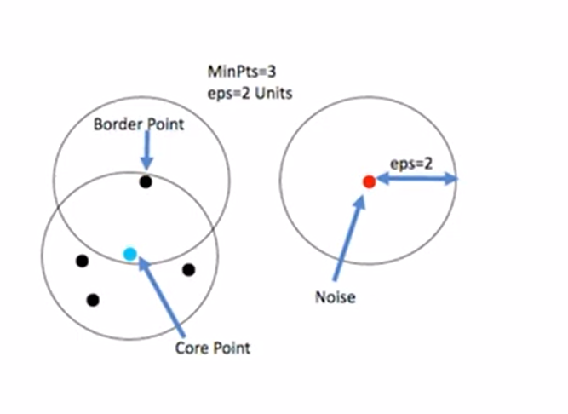
DBSCAN

Slide 6
Density-Reachable and Density-Connected
In the context of density-based clustering, such as DBSCAN (Density-Based Spatial Clustering of Applications with Noise), the concepts of density-reachable and density-connected are crucial for understanding how clusters are formed:

Slide 7
Density-Reachable
Definition: A point ( p ) is density-reachable from a point ( q ) if there is a chain of points ( p1, p2, …, pn ) where ( p1 = q ) and ( pn = p ), and each point in the chain is directly density-reachable from the previous one.
Directly Density-Reachable: A point ( p ) is directly density-reachable from a point ( q ) if ( p ) is within a specified distance (epsilon) from ( q ) and ( q ) has at least a minimum number of points (minPts) within its epsilon neighborhood.

Slide 8
Density-Connected
Definition: Two points ( p ) and ( q ) are density-connected if there is a point ( o ) such that both ( p ) and ( q ) are density-reachable from ( o ).
Importance: This concept ensures that clusters can be formed even if the points are not directly reachable from each other but are connected through a chain of intermediate points.

Slide 9
Example
Steps:
Parameters: Set epsilon = 2 and minPts = 2.
Directly Density-Reachable:
Point B is directly density-reachable from A because B is within the distance epsilon from A and A has at least minPts points (including itself) within its epsilon neighborhood.
Similarly, C is directly density-reachable from B.
Density-Reachable:
Point C is density-reachable from A because there is a chain of points (A -> B -> C) where each point is directly density-reachable from the previous one.
Density-Connected:
Points A, B, and C are density-connected because they are all density-reachable from each other.
Points D and E are density-connected because they are directly density-reachable from each other.
Point F is not density-reachable from any other point due to its distance.
Consider a set of points in a 2D space:
A (1, 2)
B (2, 2)
C (3, 2)
D (8, 7)
E (8, 8)
F (25, 80)

Slide 10
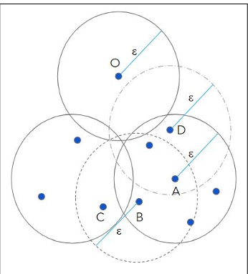
Consider min_samples = 5
A: Core point
B: Directly density reachable point from A
A and C are density connected and density reachable
D: Border point
O: Noise point

Slide 11
DBSCAN - procedure
Step-1: Decide the parameters: epsilon (ε) and minPts
Step-2: Choose a starting point P randomly and find its ε-neighbourhood.
Step-3: If P is a core point, find all density-reachable points from P and form a cluster else mark P as a noise point.
Step-4: Find next unvisited point and follow the same steps as P
Step-5: Repeat this procedure till all the points are marked visited

Slide 12
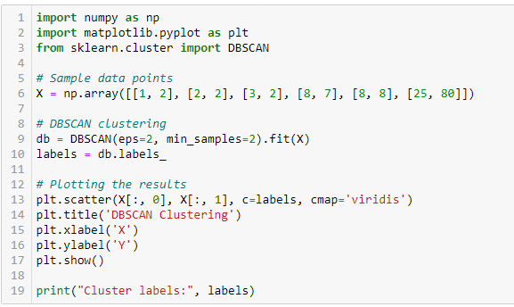
Python code
Consider a set of points in a 2D space:
A (1, 2)
B (2, 2)
C (3, 2)
D (8, 7)
E (8, 8)
F (25, 80)

Slide 13
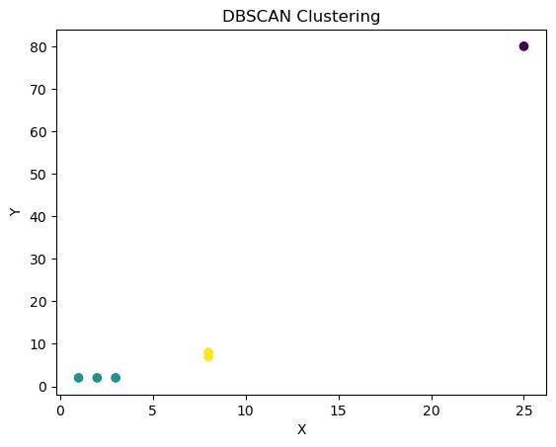

Output:
Cluster 1: A, B, C
Cluster 2: D, E
Noise: F (it is not part of any cluster)

Slide 14
DBSCAN | K-Means
In DBSCAN we need not specify the number of clusters. | K-Means is very sensitive to the number of clusters so it need to specified
Clusters formed in DBSCAN can be of any arbitrary shape. | Clusters formed in K-Means are spherical or convex in shape
DBSCAN can work well with datasets having noise and outliers | K-Means does not work well with outliers data. Outliers can skew the clusters in K-Means to a very large extent.
In DBSCAN two parameters are required for training the Model | In K-Means only one parameter is required is for training the model

Slide 15
